Slide 1

Presenter: Muhammad Ali Presented To: Sir Yasir Afridi And the Rest of the class Members.
UNIVERSITY OF ENGINEERING AND TECHNOLOGY
PESHAWAR

Slide 2
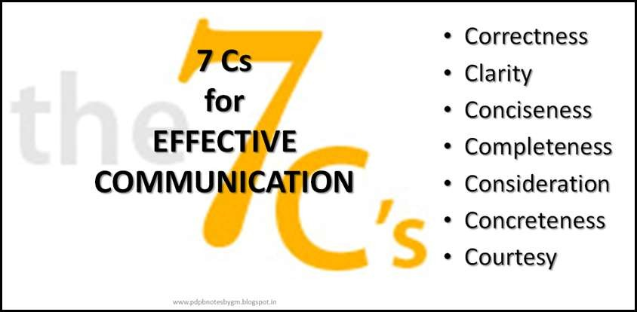
Principles of Effective Communication

Slide 3
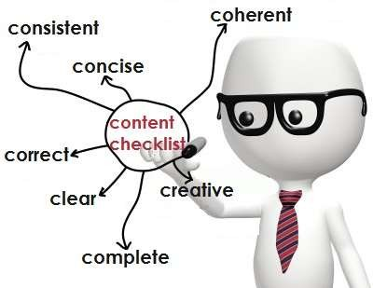
The 7 C’s
Completeness
Conciseness
Consideration
Concreteness
Clarity
Courtesy
Correctness

Slide 4

Completeness
The communication must be complete
It should convey all facts required by the audience.
The sender must take into consideration the receiver’s mind set
Features:
 No crucial information is missing
 Gives additional information
 Leaves no questions unanswered

Slide 5
Check for five Ws & one H for completeness
–Who
–What
–When
–Where
–Why and
–How

Slide 6
Conciseness
It means wordiness - communicating what you want to convey in least possible words.
Features:
 Highlights the main message
 Avoids using excessive and needless words.
 Provides short and essential message in limited word.
 Message becomes appealing and comprehensible to the audience.

Slide 7
Eliminate Wordy Expressions
 Use single words in place of phrases. Even Winston Churchill made extensive use of simple, one syllable words
Example
 Wordy:
 Concise:
At this time Now
 Wordy:
 Concise:
Due to the fact that Because

Slide 8

Cut it Short…!
Due to the fact that
Employed the use of
Basic fundamentals Completely eliminate
Alternative choices
Actual experience
Connected together
Final result
Prove conclusively
In as few words as possible
Because
Used
Fundamentals
Alternatives
Experience
Connected
Result
Prove
Concisely

Slide 9
Consideration
 Implies “stepping into the shoes of others”.
 Take note of audience’s view points, background, mind-set, education level, etc.
 Envisage your audience, their requirements, emotions and problems.
 Modify your words to suit the audience’s needs
Features :
 Emphasize on “you” approach. Show optimism towards your audience.
 Empathize and exhibit interest in audience to stimulate a positive reaction

Slide 10

Concreteness
Be particular and clear rather than fuzzy and general.
It strengthens the confidence.
Concrete messages are not misinterpreted.
Features:
 It is supported with specific facts and figures.
 Make use of words that are clear and that build the reputation.

Slide 11
Example
Vague, General, Indefinite
 Student GMAT scores are higher.
Concrete, Precise
In 1996, the GMAT scores averaged 600; by 1997 they had risen to 610.

Slide 12

Clarity
Clarity emphasise a specific message or goal at a time, rather than trying to achieve too much at once.
Features:
 It makes understanding easier.
 Clarity of thoughts and ideas enhances the meaning.

Slide 13
later agree try replace
Eg : Use simple words
Subsequent
Accede
Endeavour
Supersede
Disclose
show

Slide 14
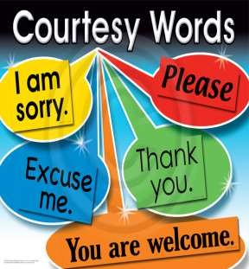
Courtesy
 Shows sender’s expression and respect to the receiver.
 The sender of the message should be sincerely polite, judicious, reflective and enthusiastic.
Features:
 Taking into consideration both viewpoints and feelings of the receiver.
 Courteous message is positive and focused at the audience.
 Use terms showing respect for the receiver of message.

Slide 15

Correctness
Implies there are no grammatical errors in communication.
Features:
 The message is exact, correct and well-timed.
 Correct communication, boosts the confidence level.
 Correct message has impact on the audience/readers.
 Precision and accurateness of facts and figures given importance
 Use appropriate and correct

Slide 16
The right form of language, accuracy and acceptable words
Select the right level of language for your communication either formal or informal.
Check for correct figures, facts, and words.
Apply the principles of communication to your writing.
17

Slide 17


